Slide 1
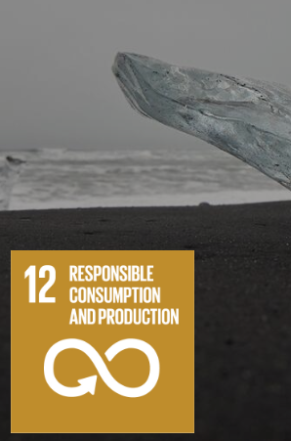
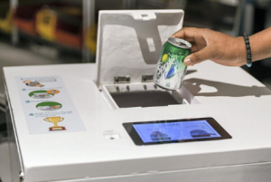
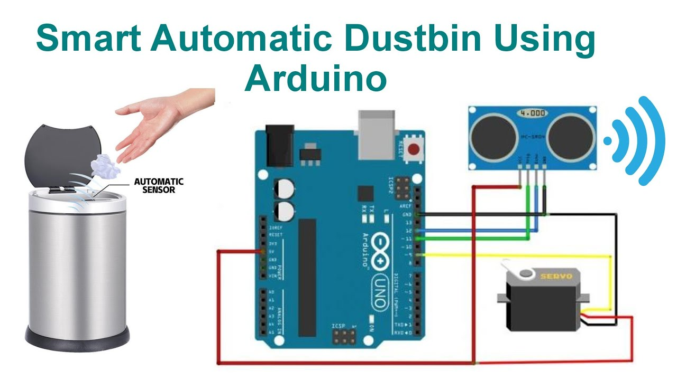
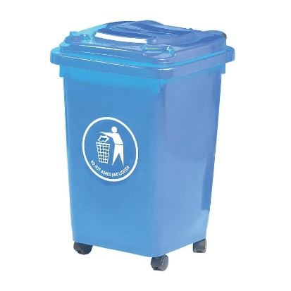
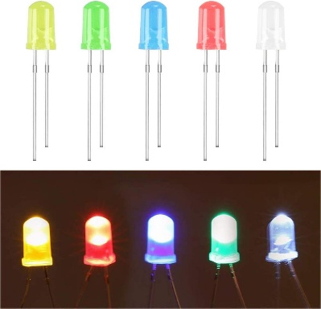
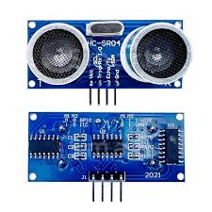
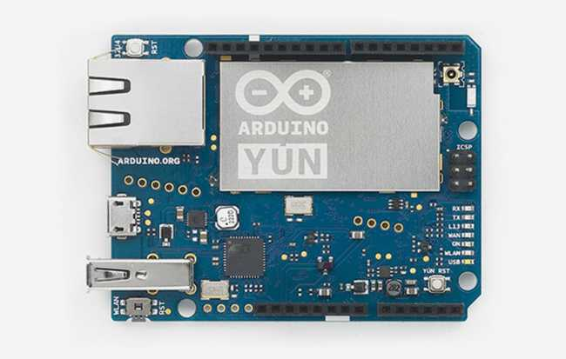
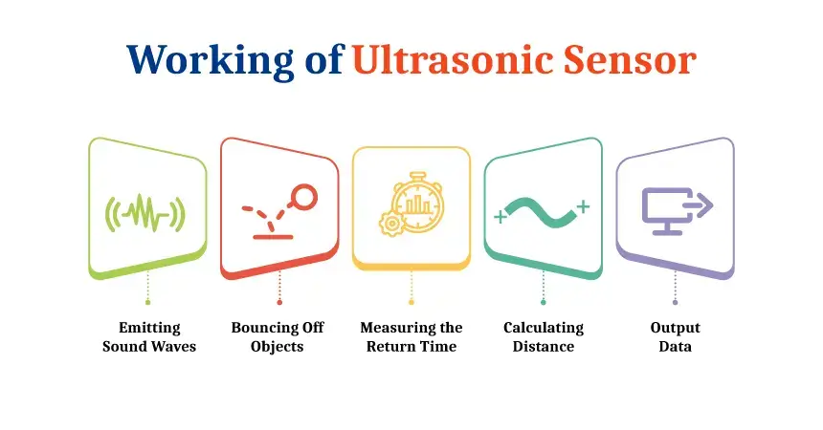
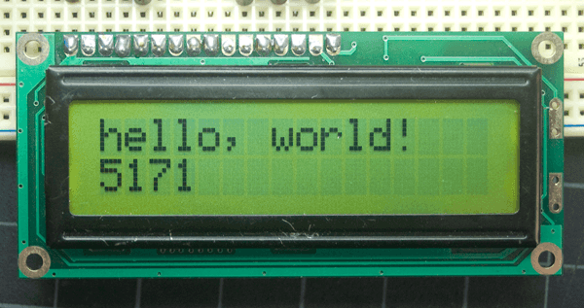
This Scientific Poster Template Is Provided By PosterNerd
Arduino Smart Bin
Liam Newton, Conor Dwyer & Keelan Boyle
ATU Sligo
Introduction
Conclusion
For our group project we wanted to focus on the effect of waste disposal on the planet today. We decided we wanted to create a smart bin that ensures the user can dispose of their waste in the most modern and efficient way possible.
To conclude, I think this project covered the problem of incorrect waste disposal whilst creating a modern product that could be used in households across the world or even in an outside environment.
We believe that waste disposal is one of the main issues in the world today and should be addressed more to the public.
For our design we are using and Arduino Yun board as well as an ultrasonic sensor, a display screen and LEDs.
Our goal is to create a stylish and modern fully functioning smart bin.
Materials
Results
For our project we are using a plastic bin, an Arduino Yun board, an ultrasonic sensor, LEDs and a display screen.
The final design of the smart bin should be fully functional with all components used. The bin should be consistent in operating how it is supposed to.
Methodology
The ultrasonic sensor will detect when a hand is placed near the bin which will allow the bin to open.
The LED will light up red when the smart bin is open signaling to the user that the bin is open and in use.
The display screen will show the text “Please bin your rubbish” when the bin is opened. It will also display “Thank you” for a few seconds once the bin is closed again.

